Slide 1
Unlocking the Full Potential of Solvay Employees
QTEM DATA CHALLENGE
TEAM 6: ON OUR WAY TO SOLVAY

Slide 2
‘Our people are the lifeblood of our Group. And in a fast-changing world, disrupted by digital, they are the key enablers of Solvay’s success.’
- Solvay Annual Integrated Report, 2018

Slide 3
Summary of analytical process
Creation of an enhanced dataset
Original data
Research focus
Can we predict employee performance?
Use of 5 predictive models and a clustering analysis
Regression
Decision tree
Engineered data
External data
Historical data
Can we identify factors that influence employee performance?
Random forest
Neural network
XGBoost
Evaluation of models
Recommendations based on insights
Based on Accuracy
Based on Mean-squared error
Collection of insights from the prediction's results
2 main derived recommendations
Managerial data
Focuses on the managerial population

Slide 4
Statistical Analysis

Slide 5
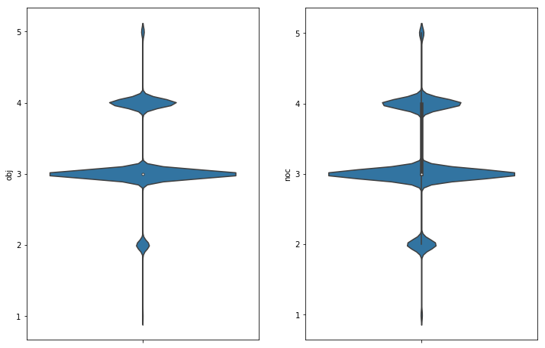
Recap: there are currently two performance metrics
The Objective Score (OBJ)
How well the employee achieved their personal goals for the year.
The Nature of Contribution score (NOC)
How well the employee’s performance influenced the company’s results
Employees are usually given an average score

Slide 6

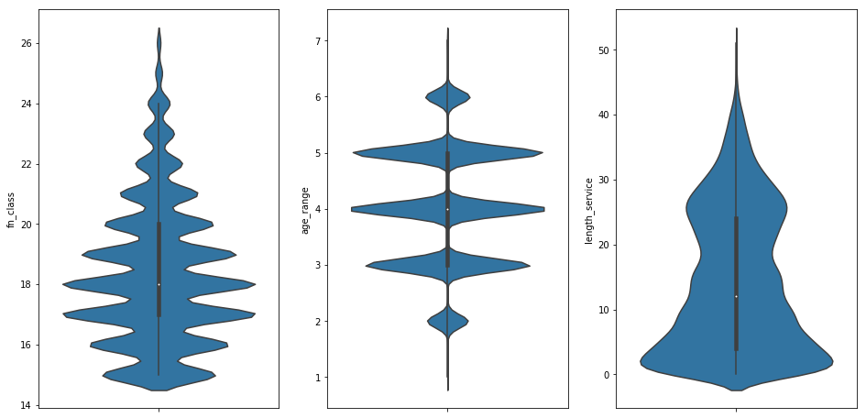
Demographics: cont.
Most people are recent hires but there is a sizeable population who’s been serving the company for a long time
Most employees are in a junior position
40-60 years old is common at Solvay

Slide 7
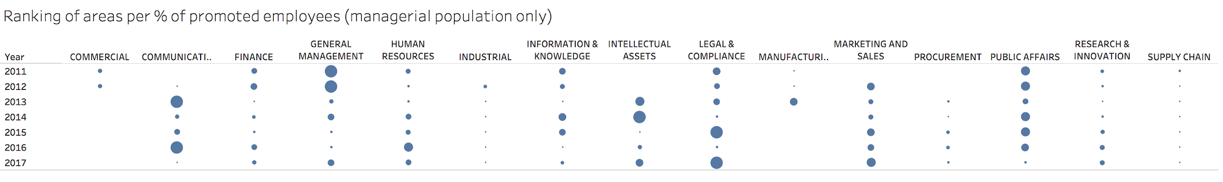
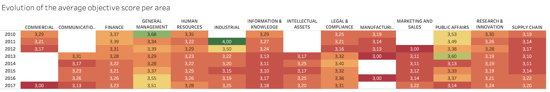
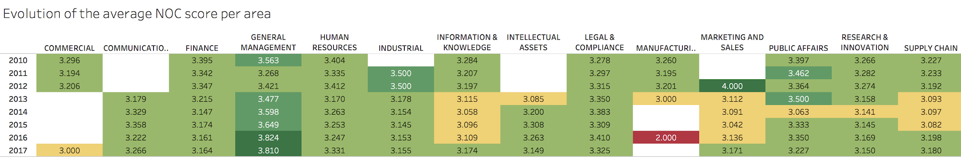
Department Analysis

Slide 8
Setting goals and tactics to improve Solvay’s performance management process
Improving employee performance
Improving performance measurement
Goals
Conducting quarterly coaching in between annual assessments
⬇ Reduce the probability of repeating bad performance
Sending automatic check-up questions to employees
⬇ Encourage employees to discuss struggles at work
Implementing anonymous manager feedback collection
⬇ Improve leadership quality and team synergy
Creating a holistic employee’s performance score
⬇ Assist HR in identifying top and bottom performers
Tactics
Supporting Technology
Machine learning performance predictor
Mobile application functionalities
Performance ranking system

Slide 9
Improve performance
1

Slide 10
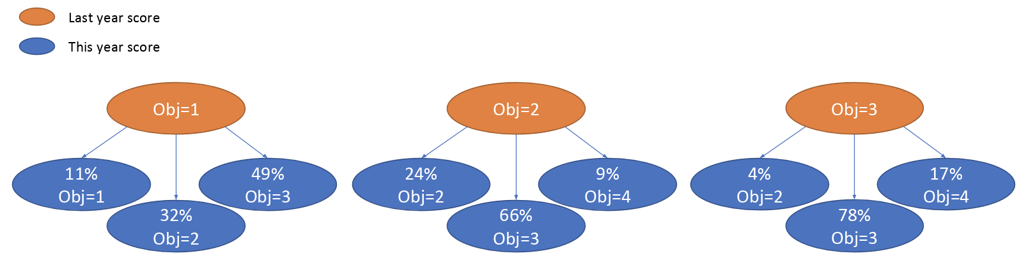


1. Improve performance
2. Measure Performance
Conclusion
Quarterly coaching
Check-up questions
Manager feedback
Insight | Past performance is the strongest indicator of future performance
Years experiencing bad performance | Chance of improving this year
1 | 15%
2 | 12%
3 | 11%
The perfect employee
The stagnating employee
37 years old
Exceeds all expectations both in OBJ and NOC
Consistent in her excellent performance
46 years old
Average performance every year
Very low probability of promotion
These employees are fictional and were obtained by a clustering analysis
Perfect employees will continue to have an excellent performance in the future
Stagnating employees will continue to have average/low scores in the future

Slide 11
1. Improve Performance
2. Measure Performance
Conclusion
Quarterly coaching
Check-up questions
Manager feedback
Recommendation | Conduct quarterly coaching to monitor the employee’s progress during the year
Benefits
Use the model prediction as a benchmark Frequent assessments prevent repeating a bad performance at year end Annual appraisal is less complicated
Prediction
(XGBoost)
Coaching
Coaching
Coaching
Annual assessment
Year start
Year end
10

Slide 12
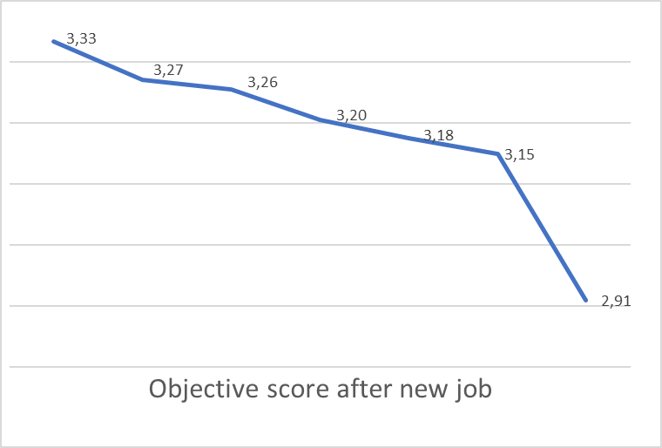
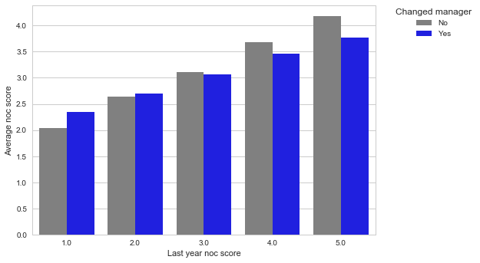


1. Improve Performance
2. Measure Performance
Conclusion
Quarterly coaching
Check-up questions
Manager feedback
Insight | Changes at work can influence employee performance
Job change
Manager change
The one experiencing a new job crisis
The one struggling with his new manager
Just changed manager
In the company for 10 years
Drop in performance
40 years old
Just changed job
Doesn’t meet his personal objective goals
These employees are fictional and were obtained by a clustering analysis

Slide 13
1. Improve Performance
2. Measure Performance
Conclusion
Quarterly coaching
Check-up questions
Manager feedback
Recommendation | Send automatic check-up questions to employees experiencing changes at work through the HR mobile application
Benefits
Encourage employees to discuss their problems Automatic actions Customized questions and notification frequency
What was challenging about the tasks you’re assigned to?
Employee receives notification each month for 6 months
Your reply…
Was there any challenge collaborating with your team?
Example:
New job check-up
Your reply…
Answers are forwarded to the manager

Slide 14
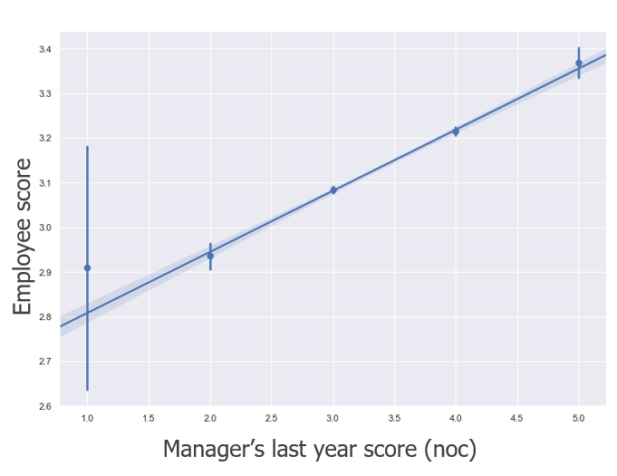

1. Improve Performance
2. Measure Performance
Conclusion
Quarterly coaching
Check-up questions
Manager feedback
Insight | Manager performance has a positive correlation with employee’s performance
Meet the Excellent Manager
36 years old
Leads a team of 3 people
Excellent performance
This employees is fictional and was obtained by a clustering analysis

Slide 15

1. Improve Performance
2. Measure Performance
Conclusion
Quarterly coaching
Check-up questions
Manager feedback
Recommendation | Implement anonymous employee survey on manager’s effectiveness
Manager and peer employees are assigned to their own group
Benefits
Employee feedback is beneficial to manager’s improvement Integration with a peer feedback system A valuable source of information to be used in quarterly / annual assessments
Passive feedback: employees are notified to assess their managers and peers
Active feedback: employee can actively select a group member to give praise / suggestion

Slide 16
Measure Performance
2

Slide 17
1. Improve Performance
2. Measure Performance
Conclusion
Quarterly coaching
Check-up questions
Manager feedback
Recommendation | Create one indicator of performance for the entire managerial population of Solvay
Before | After
Multitude of indicators of performance | 1 score for each employee
Not comprehensive enough | Allows ranking and comparison
Comparisons between employees are difficult | Easy to track the employee progress
 | Implementation at different levels
 | Employees are motivated

Slide 18
The score would include different performance metrics
1. Improve Performance
2. Measure Performance
Conclusion
Quarterly coaching
Check-up questions
Manager feedback
Criteria | How it works
Objective score | If obj = 2 → 1 point | If obj = 3 → 2 points | If obj = 4 → 3 points | If obj = 5 → 4 points
NOC score | If noc = 2 → 1 point | If noc = 3 → 2 points | If noc = 4 → 3 points | If noc = 5 → 4 points
Good performance streak (obj) | 1 point for each year with objective score > 3. The maximum is 2 points
Good performance streak (noc) | 1 point for each year with objective score > 3. The maximum is 2 points
Promotion | 1 point if performance of this year leads to a promotion next year
Fast progress | 1 point if the employee will be promoted in less time than the average
Good adaptation | 1 point if the employee changed job and still achieved an average of NOC and OBJ score higher than 3
Good manager | If the manager’s team achieved an average of OBJ and NOC score higher than 3 → 1 point If the manager’s team achieved an average of OBJ and NOC score higher than 4 → 2 points
The sum of all the points give the score of the employee for that year

Slide 19
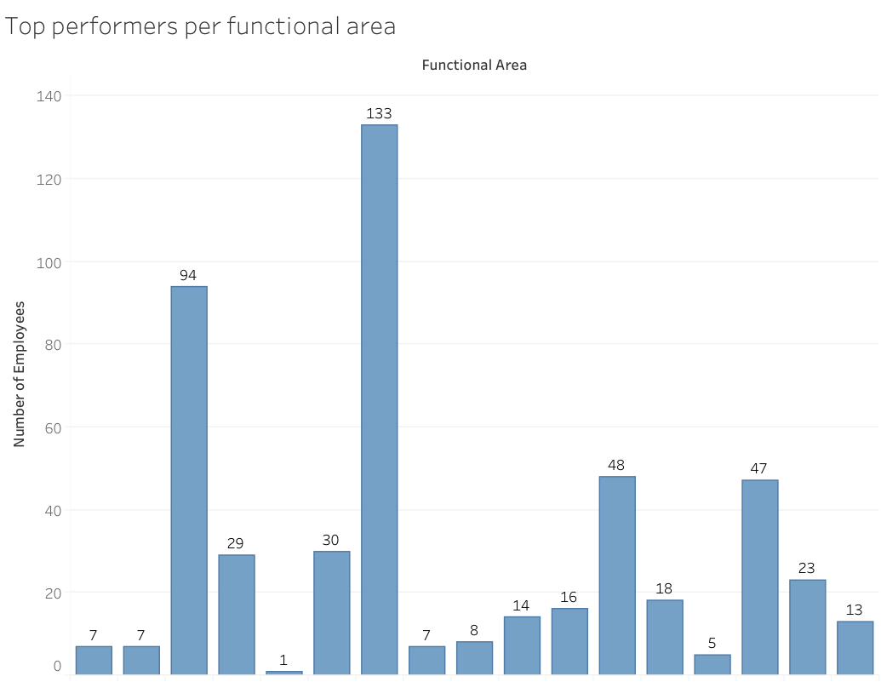
Analysis of the top 500 employees (2010-17) using the scoring system
The 4th department represents 1.4% of all employees but almost 6% of the top performers
The 3rd department represents 8% of all employees and almost 19% of top performers

Slide 20
In conclusion…
How can Solvay use HR data and improve employee performance?

Slide 21
1
Improve performance
Conduct quarterly assessments in between annual assessments to avoid employees falling into a streak of bad performance
Send automatic check-up questions to targeted groups of employees
Implement anonymous manager feedback
Improving Solvay’s performance management process in 2 steps
2
Develop a holistic scoring system to
Analyze performance as a whole in the company and identify over/under-performing groups
Allow global view on employee performance

Slide 22
Appendix

Slide 23
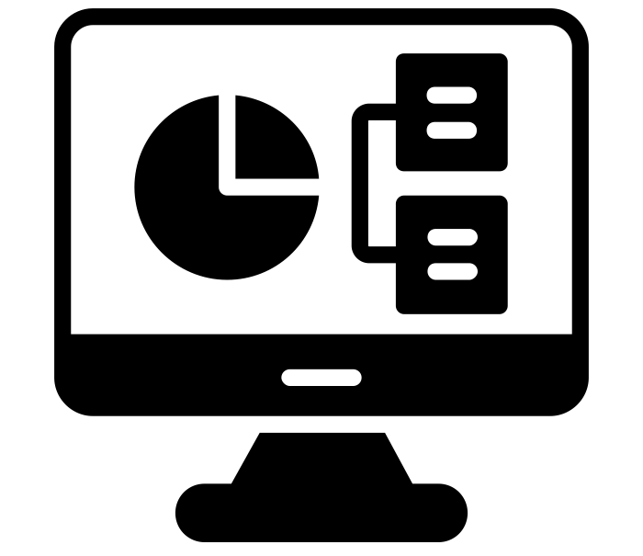
Training the models
Dataset 1: basic features
Dataset 2: all features
Original Data
Engineered Data
External Data
Dataset 1
Historical Data
Managerial Data
E.g: did the employee change job?
E.g: GDP growth
E.g: past performance
E.g: function class
We created 2 datasets to train our models
Dataset 1 can be useful for predicting employees with limited data, e.g. new employees or employees not in a managerial position.
To keep it concise, we only include the results on dataset 2 in this report.

Slide 24
Modelling Process
Specifying the model parameters
Regression
Decision Tree
max_depth = {3 – 10}
Random Forest
max_depth = 3
n_estimators = {25, 50, 100, 200}
XGBoost
objective=reg:linear, colsample_bytree=0.3, learning_rate={0.05, 0.1, 0.2}, max_depth=4,
alpha=10
Deep Learning
optimizer = adam, epochs=30, batch_size=10
Train
Validation
Test (20%)
Cross-validation
Prediction
Best parameters

Slide 25
Predicting employee performance: model comparison
Model | Objective score |  | Nature of Contribution score
 | Accuracy | Mean-squared error | Accuracy | Mean-squared error
Regression | 73.72% | 0.2786 | 73.64% | 0.2919
Decision Tree | 73.92% | 0.2788 | 73.12% | 0.3001
Random Forest | 72.67% | 0.2966 | 73.2% | 0.3039
XGBoost | 73.77% | 0.2758 | 73.47% | 0.2885
Neural Network | 73.49% | 0.2859 | 73.39% | 0.2992
Base Rate | 70.71% | 0.3284 | 63.85% | 0.4259

Slide 26
Predicting promotion: model comparison
Model | Accuracy
Regression | 89.1%
Decision Tree | 89.1%
Random Forest | 89.1%
XGBoost | 89.21%
Neural Network | 88.92%
Base Rate | 89.01%

Slide 27
Most influential factors
Predicting
Obj score | Noc score | Promotion
Previous performances | Previous performances | The employee’s function class
Manager performance | Change in manager | The manager’s function class
Time spent in the current function class | The employee’s function class | Noc score
Age | Time spent in the current function class | Age
The employee’s function class | Time spent in the current job | Time spent in the current function class
Inconclusive
Negative effect
Positive effect

Slide 28
Clustering Analysis Process
Include the most influential variables from prediction models
Multiply obj and noc score by 10
Search for 50 clusters

Slide 29
Quarterly Coaching
Of managers think annual reviews are too time consuming
31%
48%
16%
Employees like quarterly discuss
Managers do quarterly discuss
31%
66%
59%
Higher returns when goals are set quarterly versus annually
Employees would leave for lack of recognition
Solvay’s employees left after a poor score
Lack of frequent feedback and recognition
Source: Robert Half Research, Forbes

Slide 30
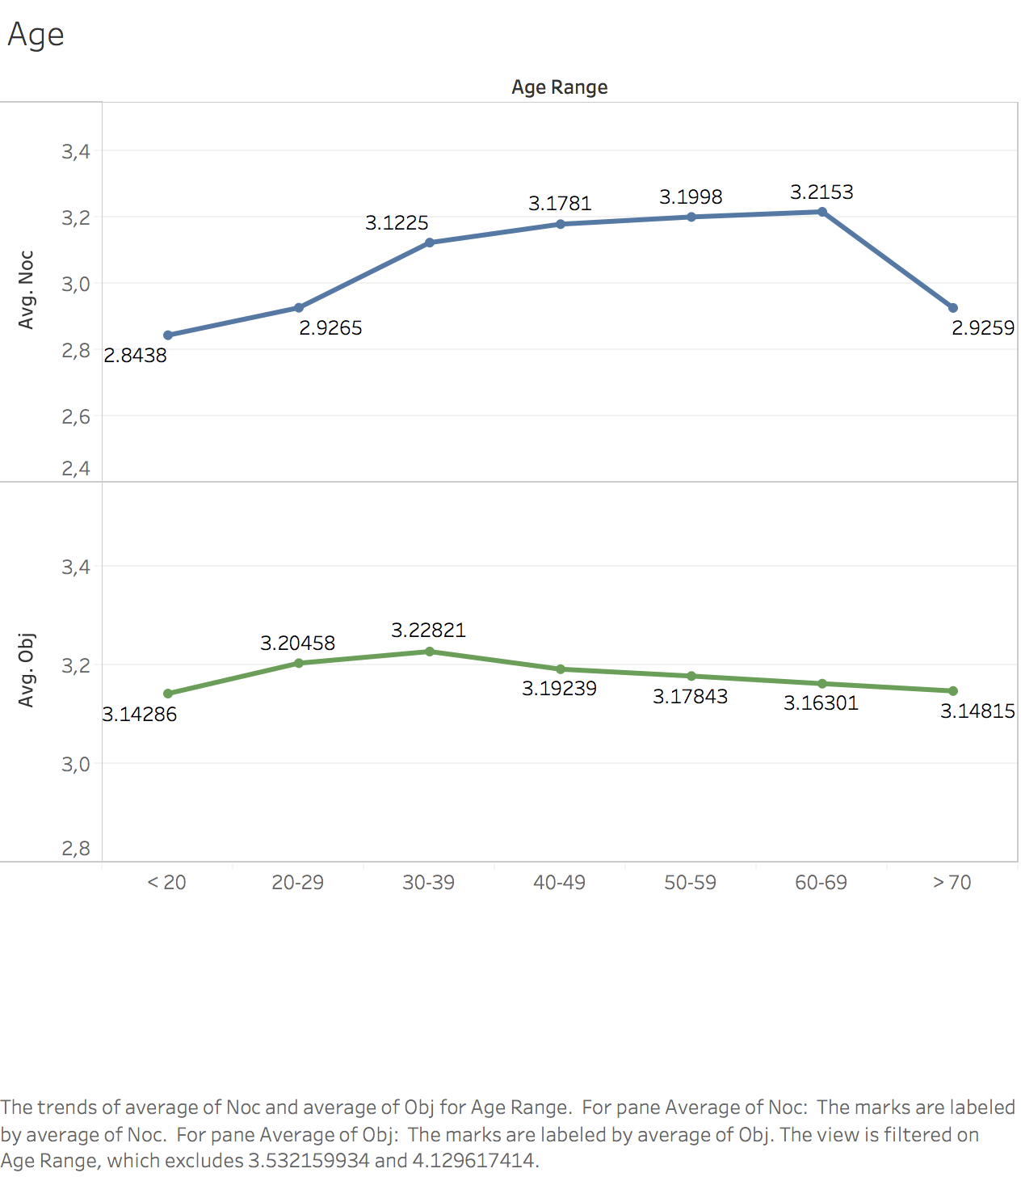
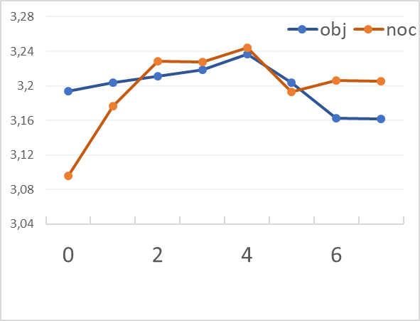
Check-up Questions: Other target groups of interest
Years spent in the same job
Age: younger than 30 and older than 50 years old
Job length: shorter than 2 years and longer than 5 years

Slide 31
Manager Feedback
57%
15%
High-achieving teams encourage upward feedback
Low-achieving teams encourage upward feedback
Source: Atlassian Research

Slide 32
References
http://rh-us.mediaroom.com/2015-10-22-Many-Employees-Left-In-The-Dark-About-Growth-Prospects-At-Work
http://rh-us.mediaroom.com/2017-04-12-THANKS-BUT-NO-THANKS-Survey-Reveals-Strangest-Forms-of-Workplace-Recognition-Research-Also-Finds-Two-in-Three-Employees-Would-Leave-Their-Job-If-They-Didnt-Feel-Appreciated
https://www.forbes.com/sites/victorlipman/2016/03/04/why-are-employee-performance-reviews-such-a-chronic-problem/#5afa43e22f3d
https://www.forbes.com/sites/joshbersin/2013/05/06/time-to-scrap-performance-appraisals/#451ad68031c3
https://www.atlassian.com/blog/leadership/how-to-give-manager-feedback
https://onlinelibrary.wiley.com/doi/abs/10.1111/j.1744-6570.1999.tb00166.x

